Slide 1
Chapter 2: Number Systems, Operations, and Codes

Slide 2
Chapter Objectives
After studying this chapter, students should be able to:
Review the decimal and binary number systems, including counting and conversions between them.
Perform binary arithmetic operations, including for signed numbers using 1’s complement, 2’s complement, and sign-magnitude.
Represent signed binary numbers in various formats: sign-magnitude, 1’s complement, 2’s complement, and floating-point.
Convert between binary, hexadecimal, and octal number systems.
Perform arithmetic in hexadecimal and BCD (Binary Coded Decimal).
Convert between binary and Gray code, and understand the ASCII character encoding.
Learn error detection methods, including basic techniques and cyclic redundancy check (CRC).

Slide 3
Chapter Outline
2.1 Decimal Numbers 2.2 Binary Numbers 2.3 Decimal-to-Binary Conversion 2.4 Binary Arithmetic 2.5 Complements of Binary Numbers 2.6 Signed Numbers 2.7 Arithmetic Operations with Signed Numbers 2.8 Hexadecimal Numbers 2.9 Octal Numbers 2.10 Binary Coded Decimal (BCD) 2.11 Digital Codes Multiple-choice test and Problems

Slide 4
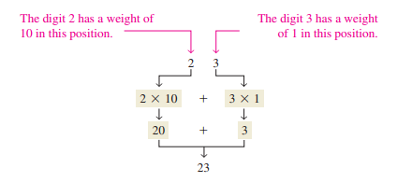
1.1. Decimal Numbers
The decimal number system has ten digits: In the decimal number system each of the ten digits, 0 through 9, represents a certain quantity.

Slide 5

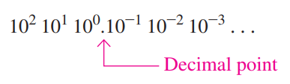
1.1. Decimal Numbers
The decimal number system has a base of 10: The position of each digit in a decimal number indicates the magnitude of the quantity represented and can be assigned a weight. The weights for whole numbers are positive powers of ten that increase from right to left, beginning with 10^0 = 1.
For fractional numbers, the weights are negative powers of ten that decrease from left to right beginning with 10^-1.

Slide 6
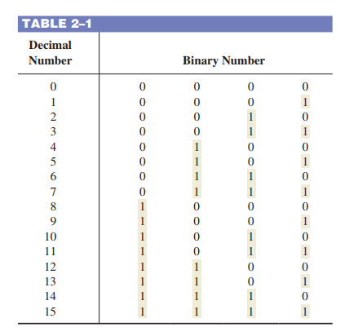
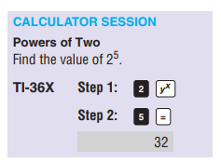
1.2. Binary Numbers
The value of a digit is determined by its position in the number.

Slide 7
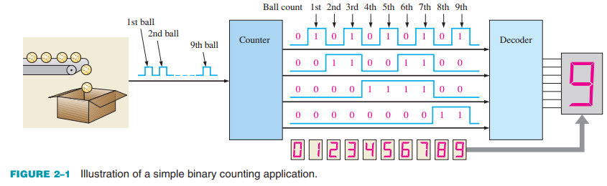
1.2. Binary Numbers
An Application
Each set of logic levels represents a 4-bit binary number (HIGH = 1 and LOW = 0), as indicated. As the decoder receives these waveforms, it decodes each set of four bits and converts it to the corresponding decimal number in the 7-segment display.

Slide 8

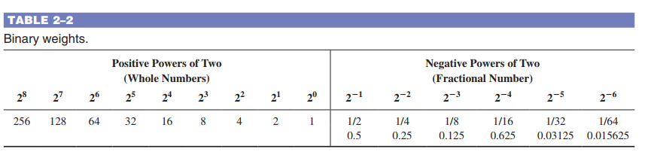
1.2. Binary Numbers
The Weighting Structure of Binary Numbers The right-most bit is the LSB (least significant bit) in a binary whole number and weights 2⁰ = 1. The weights increase from right to left by a power of two for each bit. The left-most bit is the MSB (most significant bit); its weight depends on the size of the binary number.
example, 2⁹ = 512 and 2⁻⁷ = 0.0078125

Slide 9


1.3. Decimal-to-Binary Conversion
To get the binary number for a given decimal number, find the binary weights that add up to the decimal number.
The decimal number 9, for example, can be expressed as the sum of binary weights as follows:
Placing 1s in the appropriate weight positions, 2^3 and 2^0, and 0s in the 2^2 and 2^1 positions determines the binary number for decimal 9.

Slide 10
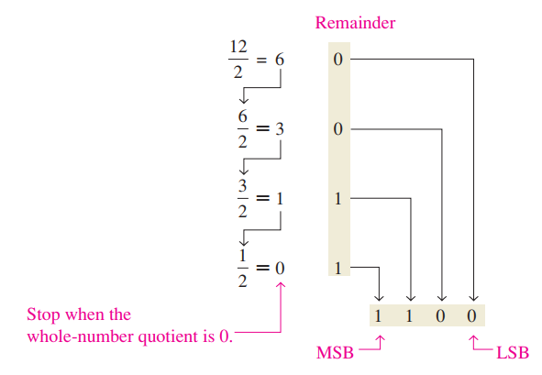
1.3. Decimal-to-Binary Conversion
Repeated Division-by-2 Method
A systematic method of converting whole numbers from decimal to binary is the repeated division-by-2 process.

Slide 11
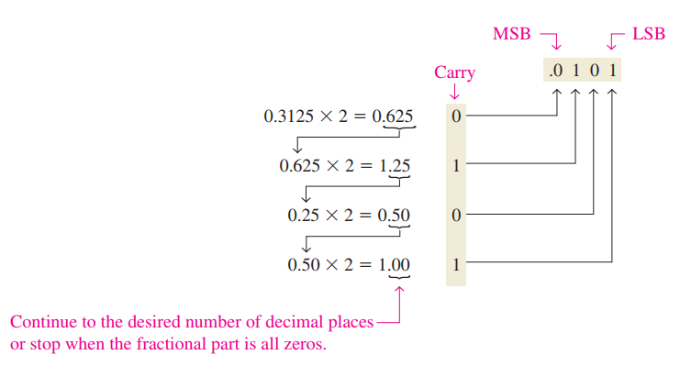
1.3. Decimal-to-Binary Conversion
Repeated Multiplication by 2 As you have seen, decimal whole numbers can be converted to binary by repeated division by 2. Decimal fractions can be converted to binary by repeated multiplication by 2.

Slide 12
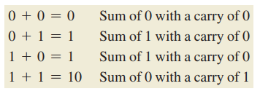
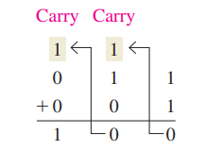


1.4. Binary Arithmetic
Binary Addition
In binary 1 1 10, not 2: The four basic rules for adding binary digits (bits) are as follows.

Slide 13
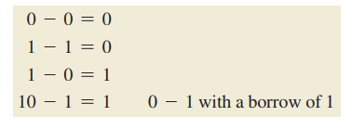
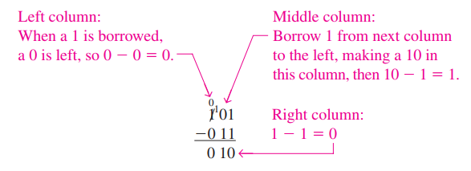
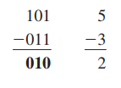
1.4. Binary Arithmetic
Binary Subtraction In binary 10 1 1, not 9: The four basic rules for subtracting bits are as follows.

Slide 14
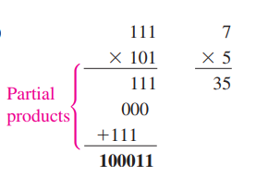
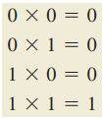
1.4. Binary Arithmetic
Binary Multiplication Binary multiplication of two bits is the same as multiplication of the decimal digits 0 and 1: The four basic rules for multiplying bits are as follows.

Slide 15
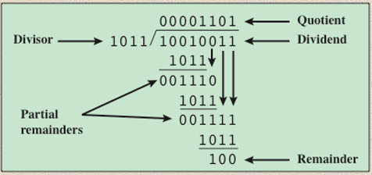
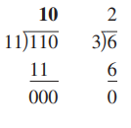
1.4. Binary Arithmetic
Binary Division A calculator can be used to perform arithmetic operations with binary numbers as long as the capacity of the calculator is not exceeded.

Slide 16

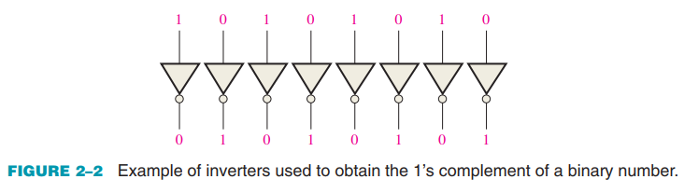
1.5. Complements of Binary Numbers
Finding the 1’s Complement The 1’s complement of a binary number is found by changing all 1s to 0s and all 0s to 1s, as illustrated below:

Slide 17
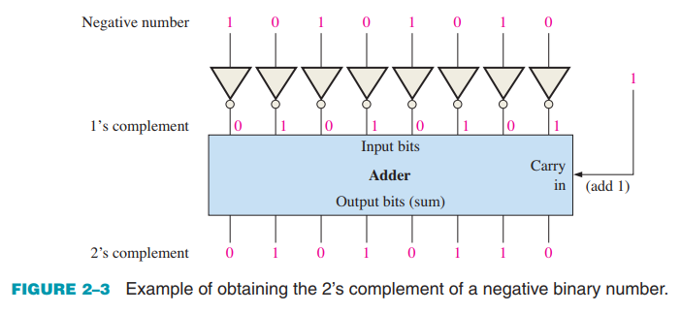
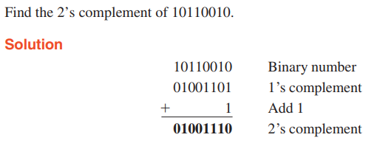
1.5. Complements of Binary Numbers
Finding the 2’s Complement
Add 1 to the 1’s complement to get the 2’s complement. The 2’s complement of a binary number is found by adding 1 to the LSB of the 1’s complement. 2’s complement = (1’s complement) + 1

Slide 18
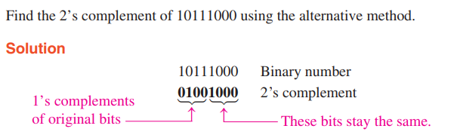
1.5. Complements of Binary Numbers
Finding the 2’s Complement
Change all bits to the left of the least significant 1 to get 2’s complement An alternative method of finding the 2’s complement of a binary number is as follows: 1. Start at the right with the LSB and write the bits as they are up to and including the first 1. 2. Take the 1’s complements of the remaining bits.

Slide 19

1.6. Signed Numbers
The Sign Bit The left-most bit in a signed binary number is the sign bit, which tells you whether the number is positive or negative. A 0 sign bit indicates a positive number, and a 1 sign bit indicates a negative number.
Sign-Magnitude Form: For example, the decimal number +25 is expressed as an 8-bit signed binary number using the sign-magnitude form as:
The decimal number 225 is expressed as
10011001

Slide 20
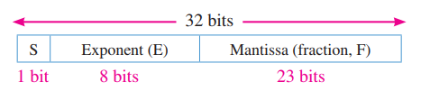
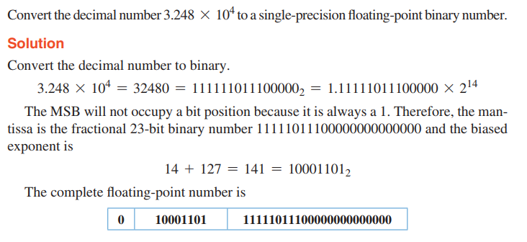
1.6. Signed Numbers
Floating-Point Numbers Single-Precision Floating-Point Binary Numbers

Slide 21
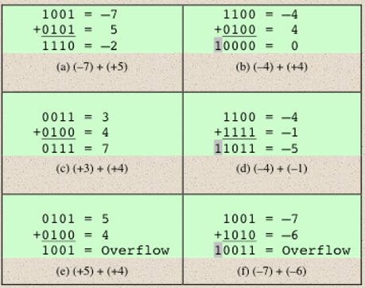
1.7. Arithmetic Operations with Signed Numbers
Addition The two numbers in an addition are the addend and the augend. The result is the sum. There are four cases that can occur when two signed binary numbers are added. 1. Both numbers positive 2. Positive number with magnitude larger than negative number 3. Negative number with magnitude larger than positive number 4. Both numbers negative

Slide 22
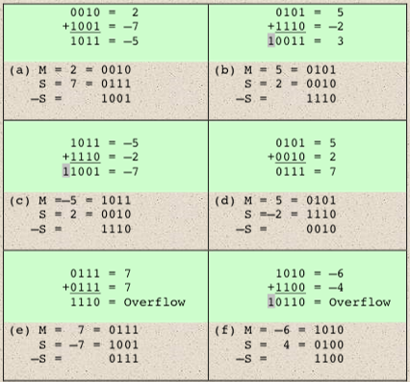
1.7. Arithmetic Operations with Signed Numbers
Subtraction Subtraction is a special case of addition. For example, subtracting +6 (the subtrahend) from +9 (the minuend) is equivalent to adding 26 to +9. Basically, the subtraction operation changes the sign of the subtrahend and adds it to the minuend. The result of a subtraction is called the difference. The sign of a positive or negative binary number is changed by taking its 2’s complement.

Slide 23
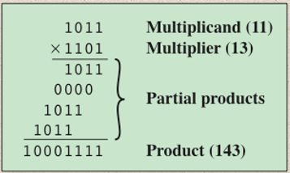
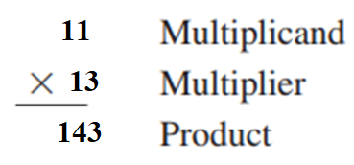
1.7. Arithmetic Operations with Signed Numbers
Multiplication The numbers in a multiplication are the multiplicand, the multiplier, and the product. These are illustrated in the following decimal multiplication:

Slide 24
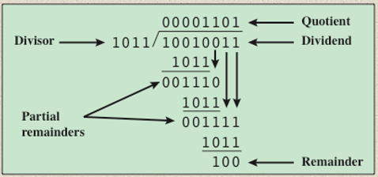

1.7. Arithmetic Operations with Signed Numbers
Division The numbers in a division are the dividend, the divisor, and the quotient. These are illustrated in the following standard division format.

Slide 25
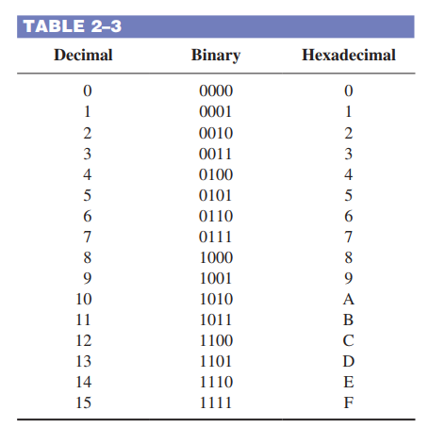
1.8. Hexadecimal Numbers
The hexadecimal number system consists of digits 0–9 and letters A–F
The hexadecimal number system has a base of sixteen; that is, it is composed of 16 numeric and alphabetic characters.

Slide 26
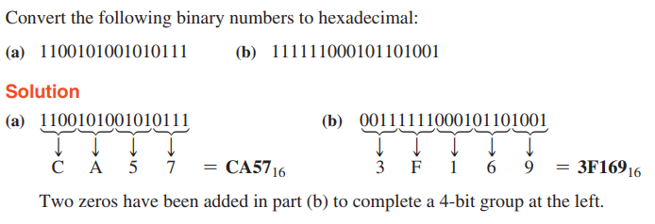
1.8. Hexadecimal Numbers
Binary-to-Hexadecimal Conversion

Slide 27
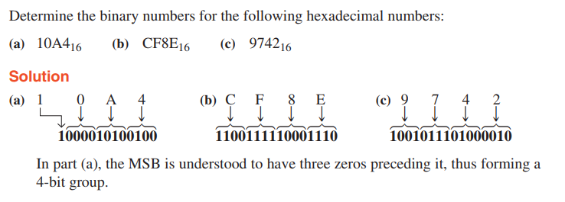
1.8. Hexadecimal Numbers
Hexadecimal-to-Binary Conversion

Slide 28
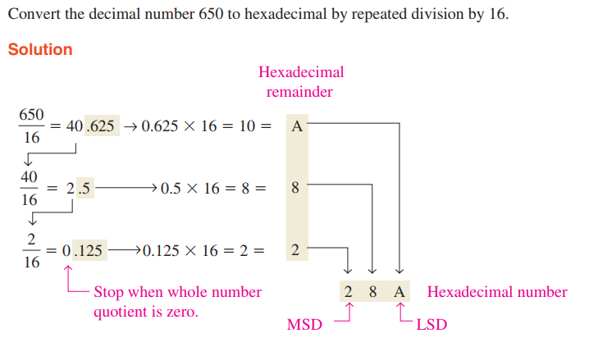
1.8. Hexadecimal Numbers
Decimal-to-Hexadecimal Conversion

Slide 29
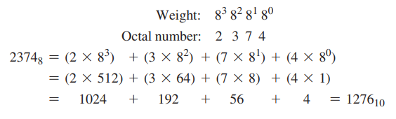
1.9. Octal Numbers
The octal number system has a base of 8. The octal number system is composed of eight digits, which are 0, 1, 2, 3, 4, 5, 6, 7 To count above 7, begin another column and start over: 10, 11, 12, 13, 14, 15, 16, 17, 20, 21, c Octal-to-Decimal Conversion

Slide 30
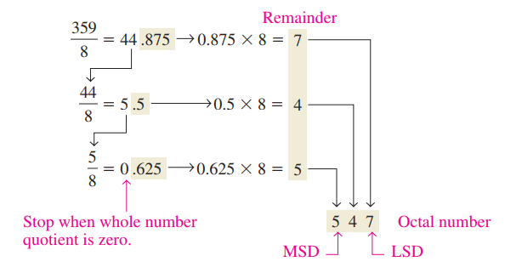
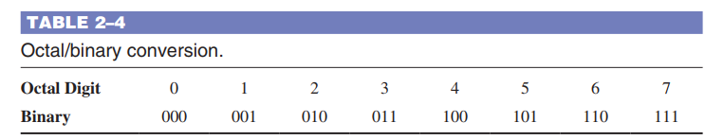

1.9. Octal Numbers
Decimal-to-Octal Conversion
Octal-to-Binary Conversion

Slide 31
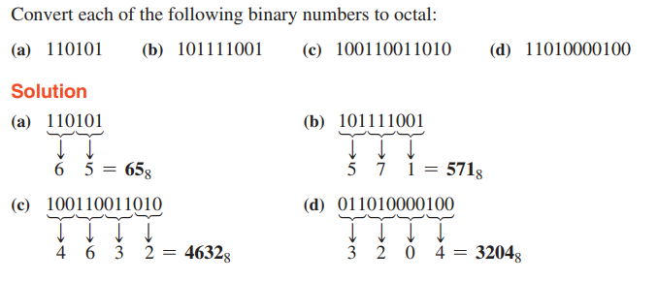
1.9. Octal Numbers
Binary-to-Octal Conversion

Slide 32
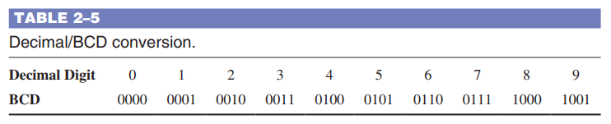
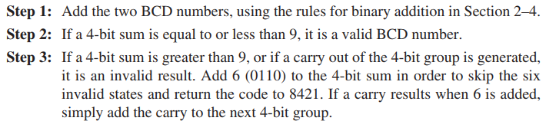
1.10. Binary Coded Decimal (BCD)
The 8421 BCD Code In BCD, 4 bits represent each decimal digit The 8421 code is a type of BCD (binary coded decimal) code. Binary coded decimal means that each decimal digit, 0 through 9, is represented by a binary code of four bits. The designation 8421 indicates the binary weights of the four bits (2^3, 2^2, 2^1, 2^0).
BCD Addition

Slide 33
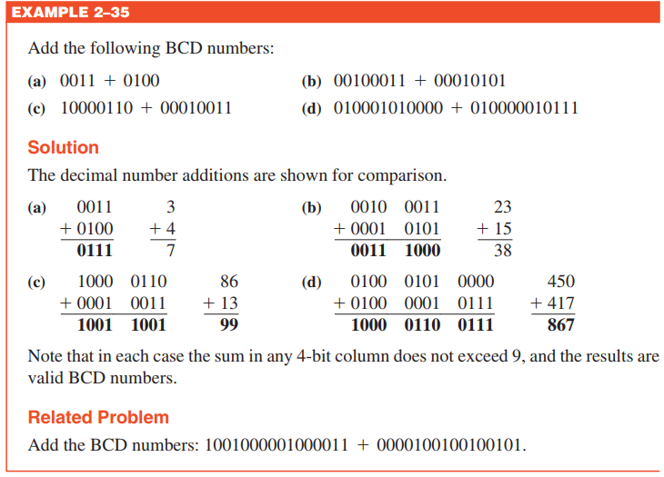
1.10. Binary Coded Decimal (BCD)
BCD Addition

Slide 34
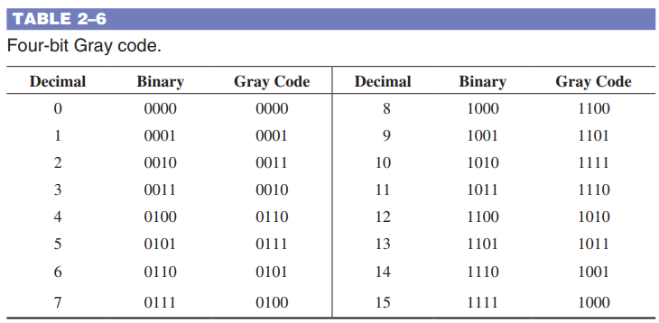
1.11. Digital Codes
The Gray Code This property is important in many applications, such as shaft position encoders, where error susceptibility increases with the number of bit changes between adjacent numbers in a sequence.

Slide 35
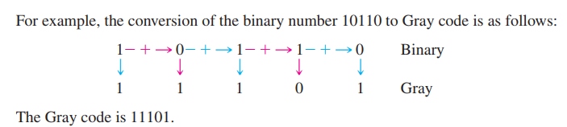
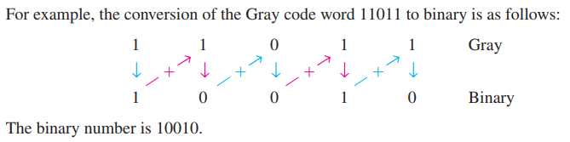
1.11. Digital Codes
Binary-to-Gray Code Conversion Conversion between binary code and Gray code is sometimes useful. The following rules explain how to convert from a binary number to a Gray code word: 1. The most significant bit (left-most) in the Gray code is the same as the corresponding MSB in the binary number. 2. Going from left to right, add each adjacent pair of binary code bits to get the next Gray code bit. Discard carries.

Slide 36
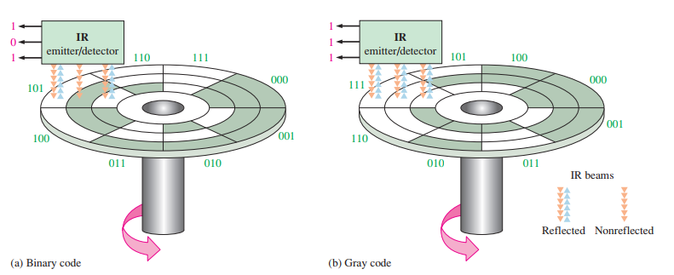

1.11. Digital Codes
An Application

Slide 37
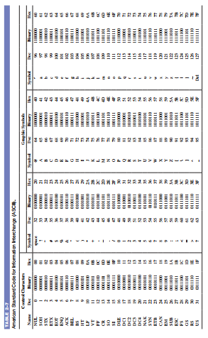
1.11. Digital Codes
ASCII ASCII is the abbreviation for American Standard Code for Information Interchange. Pronounced “askee,” ASCII is a universally accepted alphanumeric code used in most computers and other electronic equipment.
The ASCII Control Characters

Slide 38
SUMMARY
Chapter 2: Number Systems, Operations, and Codes
Binary and decimal conversions can be done using methods like sum-of-weights, division-by-2 (for decimal to binary), or multiplication-by-2 (for binary to decimal fractions).
Binary arithmetic includes addition (with basic rules like 1 + 1 = 10) and subtraction, which can be performed using 1’s or 2’s complement methods.
Signed binary numbers use a sign bit: 0 for positive, 1 for negative; overflows can occur during arithmetic operations.
Number systems: Hexadecimal uses 16 symbols (0–9, A–F); octal uses 8 symbols (0–7); both simplify binary representation and conversion.
Other codes: BCD represents decimal digits in binary form; ASCII is a 7-bit code used for characters in computing.

Slide 39
MULTIPLE-CHOICE TEST AND PROBLEMS
Complete the true/false questions, multiple-choice questions, and end-of-chapter exercises in the primary textbook.

